Slide 1
Predicting Disease Spread – Dengue Fever
Project for Introduction to Data Science (SS 18)
Maximilian Tornow

Slide 2
Overview
Why?
Data used
Exploratory analysis
Problems
Data modeling
Common linear models (optimized / non-optimized)
Tree model (XGBoost)
Negative binomial regression
Facebook Prophet
Principal Component Analysis
Autocorrelation
Conclusion
Outlook
Sources for code:
Scikit-learn: Machine Learning in Python, Pedregosa et al., JMLR 12, pp. 2825-2830, 2011.
https://github.com/SusmeetJain

Slide 3

What is Dengue Fever ?
Cause
Dengue virus (DENV), mosquito-borne RNA virus
Spreading
Yellow fever mosquito (Aedes aegypti)
Symptoms
Uncomplicated | Severe
Fever symptoms | Inner bleedings
Vomiting | Dangerously low blood pressure
Skin rash | Low blood platelet count
Muscle and joint pain | Blood Plasma Leakage
Sources: https://en.wikipedia.org/wiki/Dengue_fever
https://en.wikipedia.org/wiki/Aedes_aegypti

Slide 4
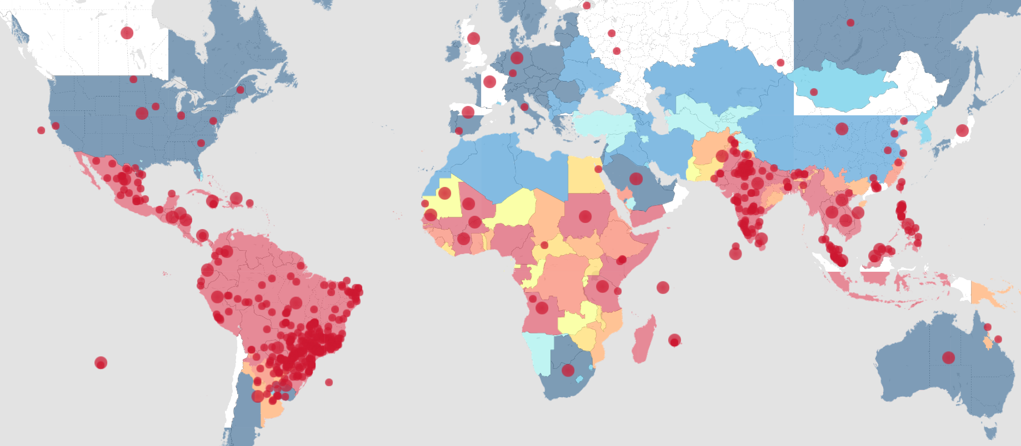
What is Dengue Fever ?
Treatment
No specific treatment, case to case decisions
With individual treatment:
“decreasing mortality rates from more than 20% to less than 1%”
Where?
Source: http://www.healthmap.org/dengue/
Source: http://www.who.int/news-room/fact-sheets/detail/dengue-and-severe-dengue

Slide 5
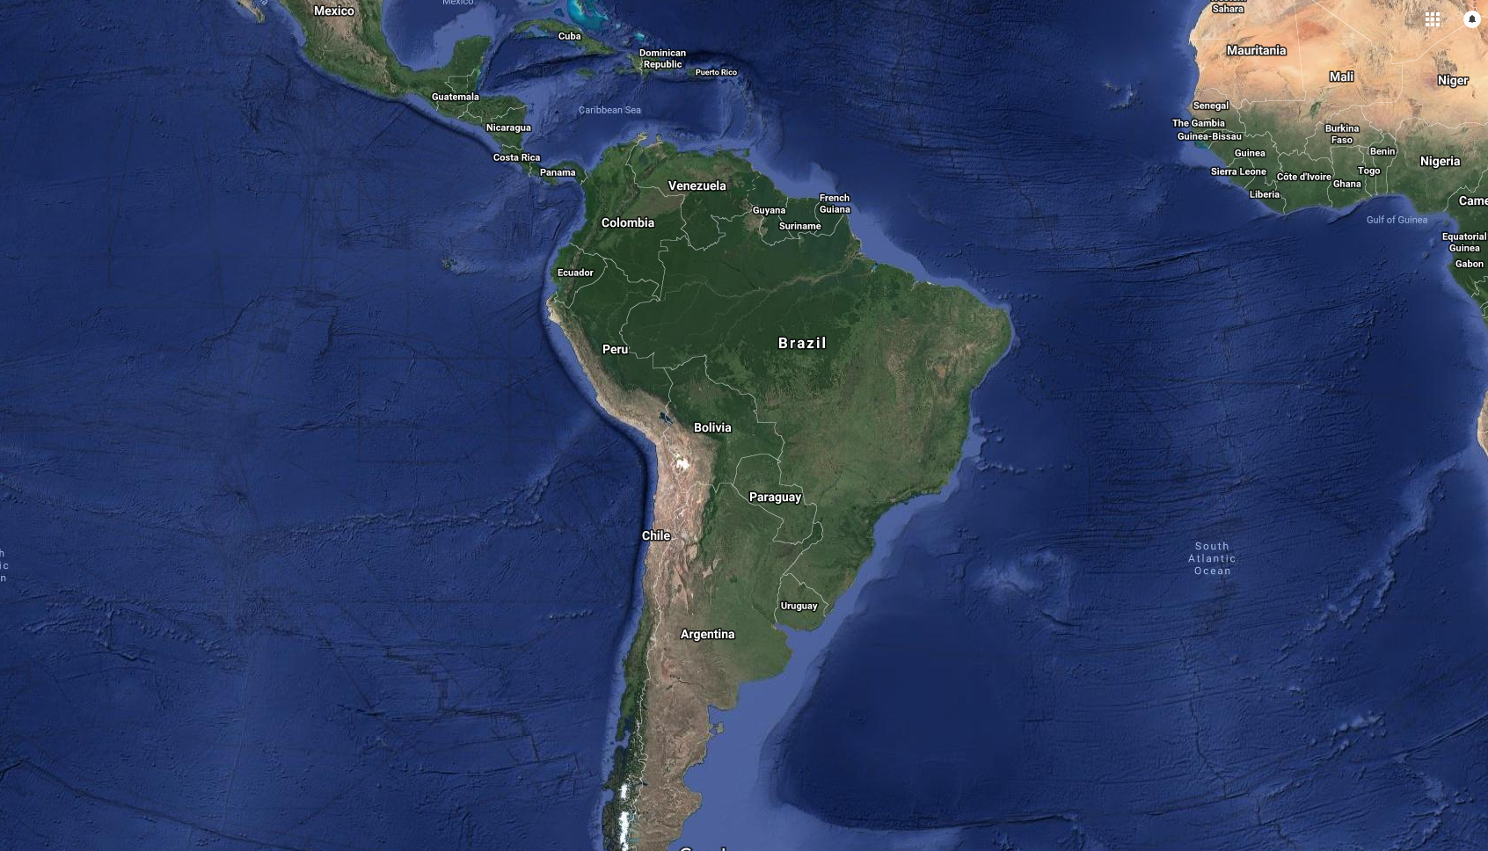
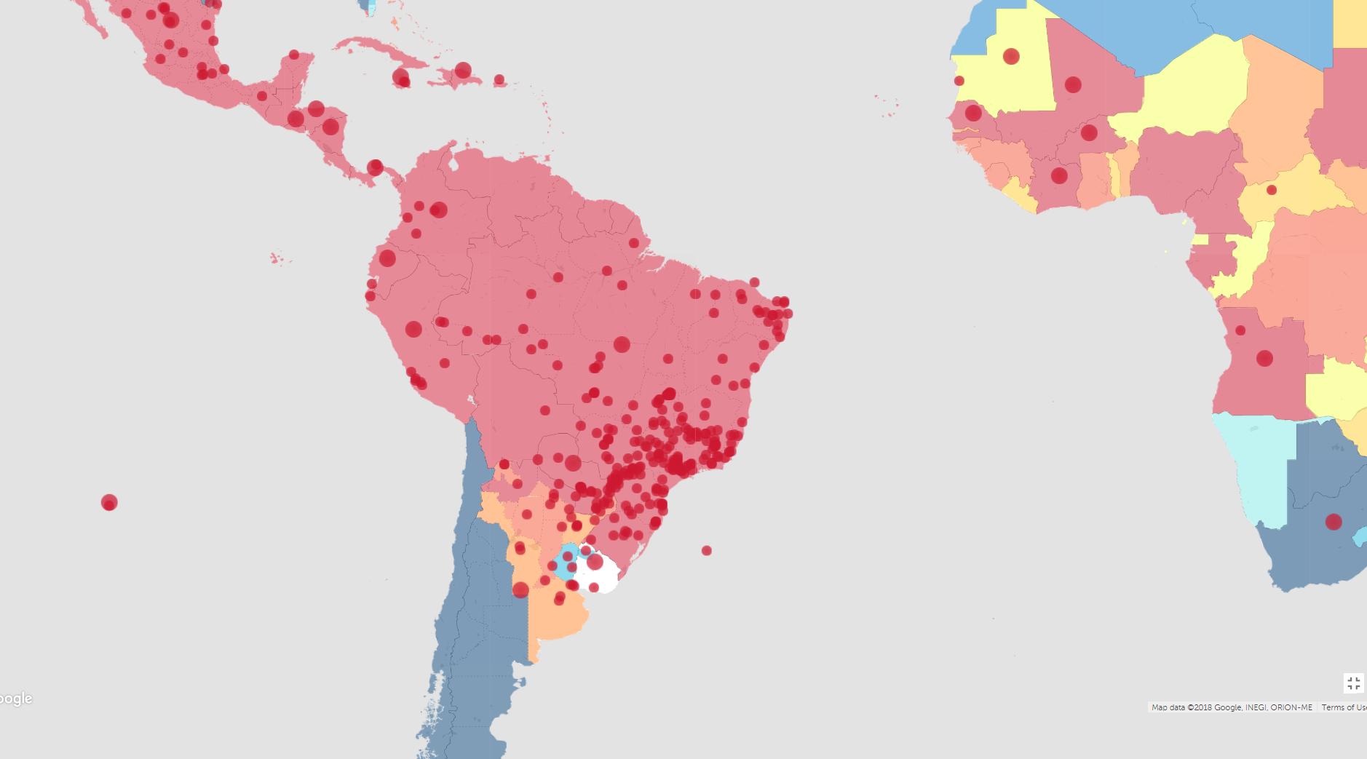
Geographical Area of Research
1
1 – San Juan, Puerto Rico
2 – Iquitos, Peru
2
Source: Google Maps
Source: http://www.healthmap.org/dengue

Slide 6
How to help ?
“decreasing mortality rates from more than 20% to less than 1%”
Prediction would help to allocate medical personal better
Decrease mortality rates
Transmitter is a Mosquito
Outbreaks could be linked to environmental data
Notes:
Outbreaks could be linked to env. Data -> linked due to breeding cycles of mosquitos

Slide 7
Research Question
How could one predict dengue fever cases for the two cities based on environmental/climate data?
Which approach will be the best?

Slide 8
Data used - General
Data from U.S. National Oceanic and Atmospheric Administration
Spanning 1990 to 2010 for San Juan, weekly interval
Spanning 2000 to 2010 for Iquitos, weekly interval
Source: http://dengueforecasting.noaa.gov/

Slide 9
Data used - Features
Daily climate data from weather stations
Max, min, avg temperature [°C], diurnal temperature variation [°C]
Total rain [mm]
PERSIANN satellite (Infrared satellite data + Artifical Neural Network)
Total rain [mm]
NOAA NCEP Climate Forecast Reanalysis
Air temperature (min, max, avg, dew point, mean) [K], diurnal temp. range [K]
Mean humidity (relative [%], specific [g/kg])
Total rain [mm]
NOAA CDR
Vegetation index (southeast, southwest, northeast, northwest of city center) [pixel]
Added week number as feature (52 features)
Source: http://dengueforecasting.noaa.gov/
Notes:
diurnal temperature variation = intraday temperature variation
NCEP Reanalysis -> fun fact: 73TB data total 1979-2011
Or month number as a feature where monthly analysis was performed
Vegetation index -> spectral satellite data that results in pixels counted (basically red/infrared ratio) -> oberservable due to plants specific absorption
NDVI = (NIR – Red)/(NIR+ Red)

Slide 10
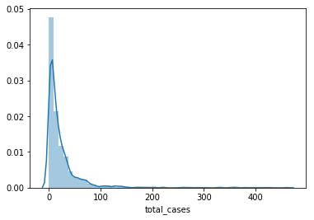
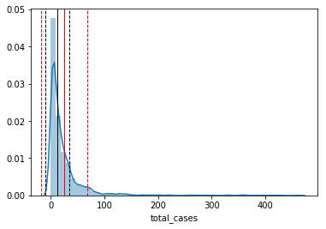
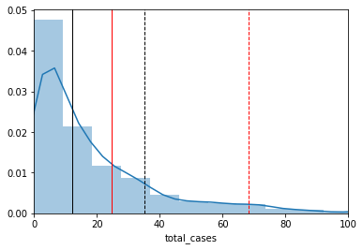
Exploratory Analysis - Distribution
Mean: 24.7 ± 43.6
Median: 12.0 ± 23.0

Slide 11
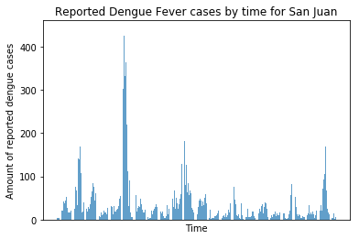
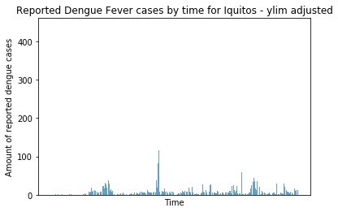
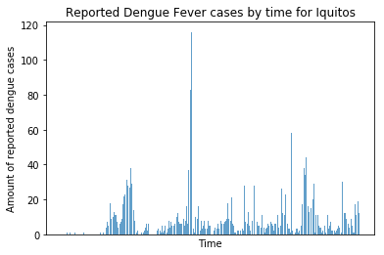
Exploratory Analysis – General time plots

Slide 12
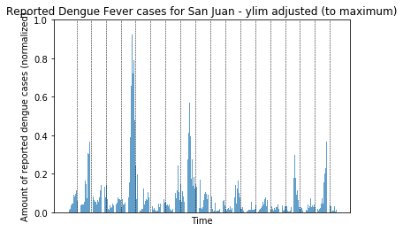
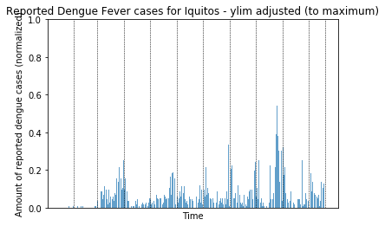
Exploratory Analysis – Yearly indications

Slide 13
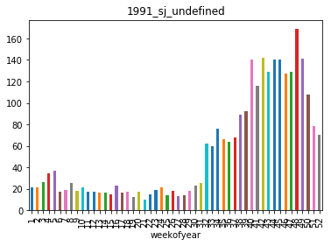
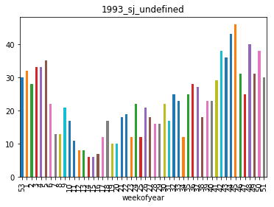
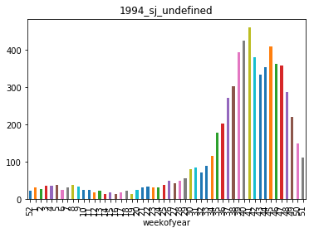
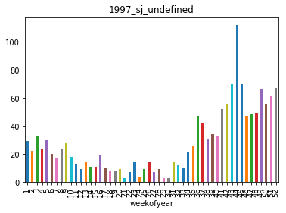
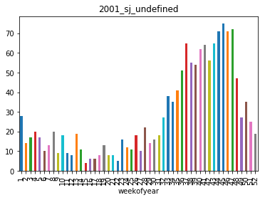
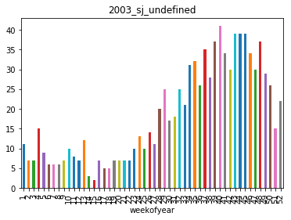
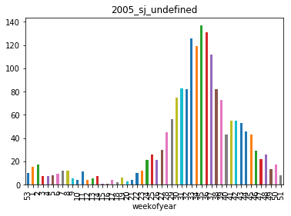
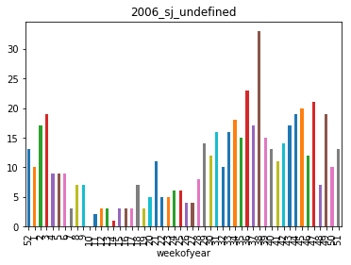
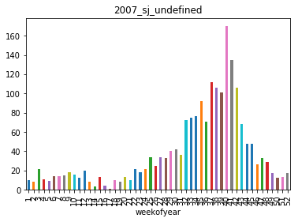
Exploratory Analysis – Time series plots unscaled
San Juan
Seems pattern driven
Notes:
Star -> year used to draw line for pattern

Slide 14
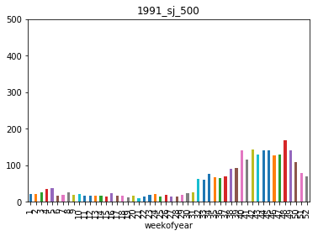
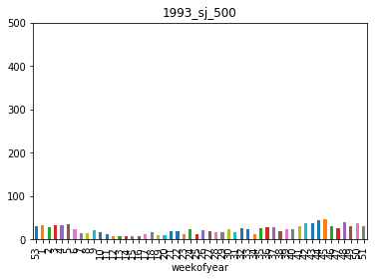
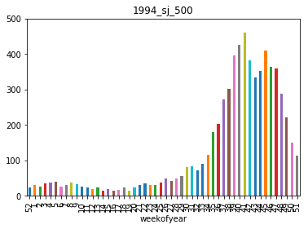
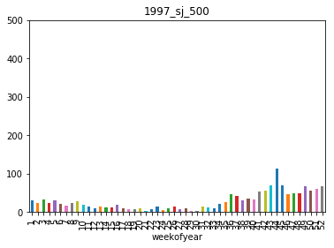
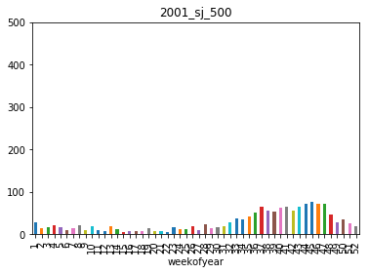
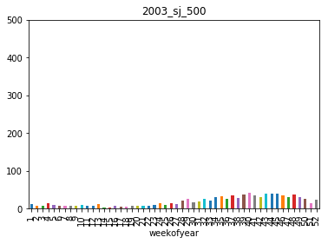
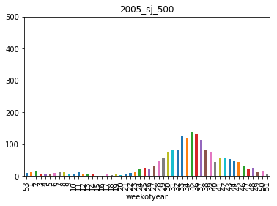
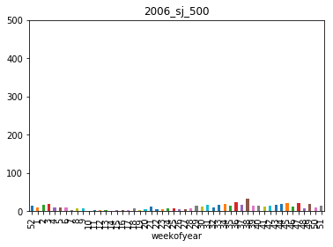
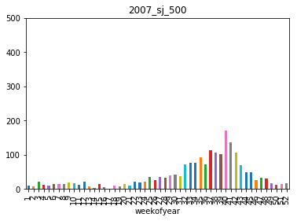
Exploratory Analysis – Time series plots scaled (500)
San Juan
Notes:
To better compare the years next to each other -> scaled them to the same y-axis

Slide 15
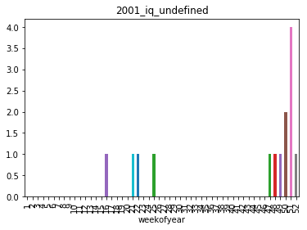
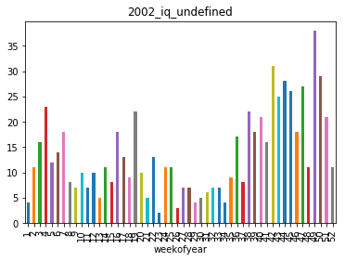
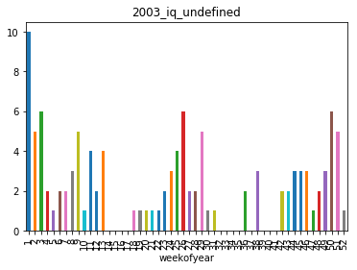
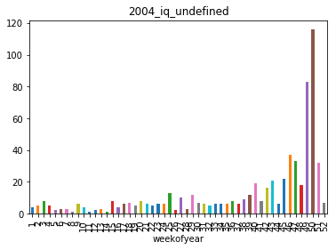
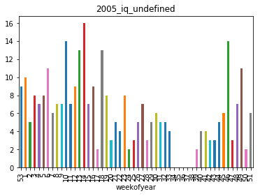
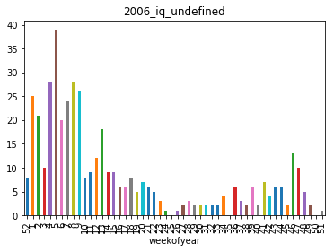
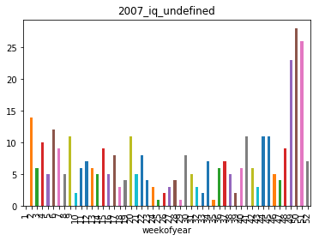
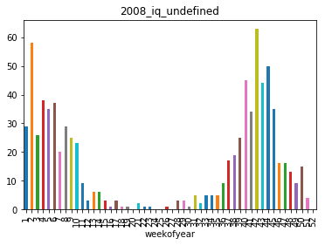
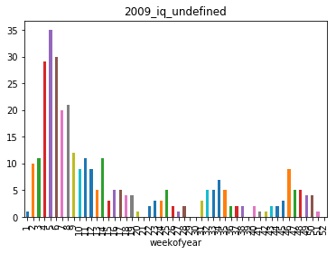
Exploratory Analysis – Time series plots unscaled
Iquitos
More irregular than San Juan
Notes:
Star -> year used to draw line for pattern

Slide 16
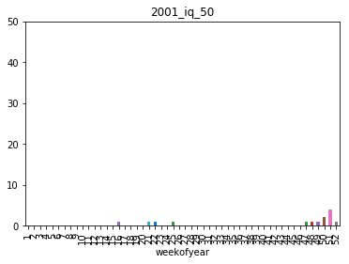
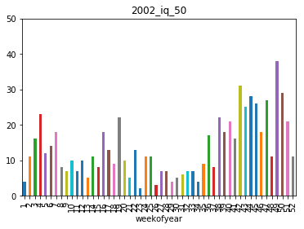
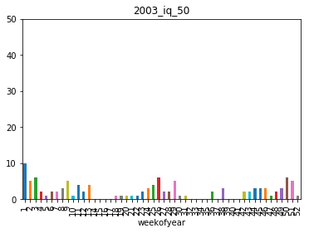
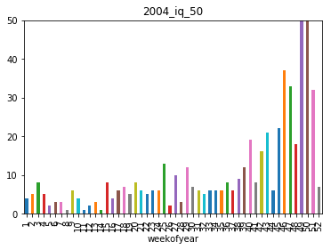
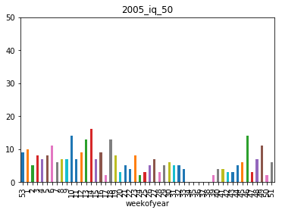
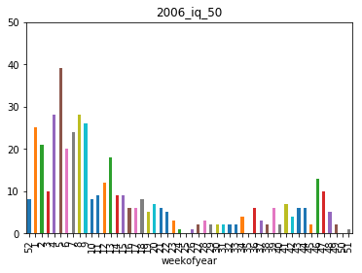
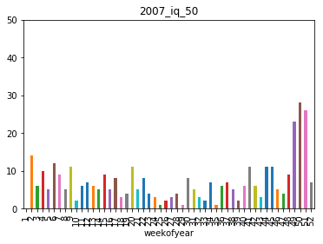
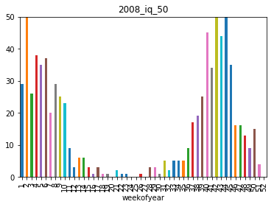
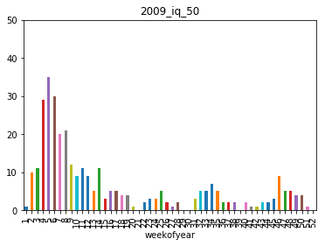
Exploratory Analysis – Time series plots scaled (50)
Iquitos
Notes:
To better compare the years next to each other -> scaled them to the same y-axis

Slide 17
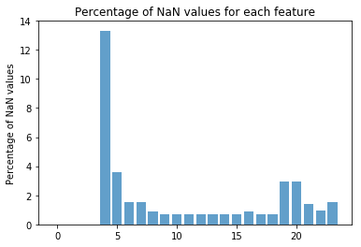
Exploratory Analysis – Feature analysis
Feature 4: high amount of NaN values
Feature 4 is NDVI_NE
Decision: Drop NDVI_NE
For others: Drop the rows with NaN
Result: ~88% of initial data was preserved
5/31/2018
Predicting Disease Spread, Maximilian Tornow
Page 17

Slide 18
Problems
Week labeling in initial data set initially hard to understand
Different features had hard to get descriptions of how they were obtained
Wanted to try a lot of models with a lot of variation
Cities (Combined, Individual), Timeframe (Monthly, Weekly), Reduced feature sets, Parameter optimization, Cross-Validation, etc.
Needed to focus on some !

Slide 19
Data modeling – Tools used
Mean model (Naive)
Linear models
Linear Regression
Ridge Regression
Lasso Regression
Gradient Boosting (XGBoosting) / Trees
Negative Binomial Regression
Facebook Prophet
PCA
Autokorrelation
Source: http://www.chioka.in/differences-between-l1-and-l2-as-loss-function-and-regularization/

Slide 20
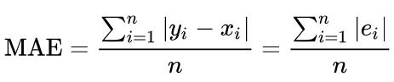
Quality factor – Mean absolute error
What?
Why?
Useable for all models
Easier to interpret then confusion matrices or RMSE
Not MPE, because data always the same therefore easier to grasp
Source: https://en.wikipedia.org/wiki/Mean_absolute_error
Notes:
RMSE = (Root Mean Squared Error)
MPE = Mean percentage error

Slide 21
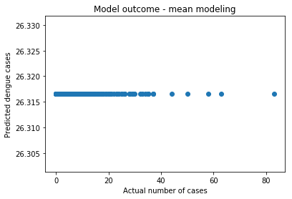
Data modeling – Mean modeling
Naive model
MAE = 19.65
Predicting Disease Spread, Maximilian Tornow

Slide 22


Data modeling – Linear regression
Optimized with
MAE = 13.18
Predicting Disease Spread, Maximilian Tornow

Slide 23


Data modeling – Ridge regression
Optimized with
MAE = 10.83
Predicting Disease Spread, Maximilian Tornow

Slide 24



Data modeling – Lasso regression (alpha optimization)
Optimized with
MAE = 8.98
α = 0.4
Predicting Disease Spread, Maximilian Tornow

Slide 25


Data modeling – Lasso regression (Recursive feature elimination)
Recursive feature elimination
MAE = 6.07
n = 2
Completly useless model (with n=2)
Would heavily be penalized by other quality indicators (RMSE)
Predicting Disease Spread, Maximilian Tornow
Notes:
iven an external estimator that assigns weights to features (e.g., the coefficients of a linear model), recursive feature elimination (RFE) is to select features by recursively considering smaller and smaller sets of features. First, the estimator is trained on the initial set of features and the importance of each feature is obtained either through a coef_ attribute or through a feature_importances_ attribute. Then, the least important features are pruned from current set of features.That procedure is recursively repeated on the pruned set until the desired number of features to select is eventually reached.
RMSE = Root mean square error

Slide 26
Data modeling – XGBoosting (untuned /tuned)
diur. temp.
MAE = 18.27 (untuned)
MAE = 12.39 (tuned)
avg. temp.
mean. temp.
precip.
humidity
max. temp.
Source: https://machinelearningmastery.com/visualize-gradient-boosting-decision-trees-xgboost-python/
Predicting Disease Spread, Maximilian Tornow
Notes:
Motivation: is used in a lot of „data competitions“, normally performs very well without a lot of tuning
Showing tree the untested model came up with
https://www.slideshare.net/MichaelBENESTY/feature-importance-analysis-with-xgboost-in-tax-audit
Leaf score shows log odd scores

Slide 27
Data modeling – Negative Binomial Regression
Decided to use model, as proposed by NOAA
3 model approaches:
San Juan
Iquitos
Combined
MAE = 25.48 (San Juan)
MAE = 5.44 (Iquitos)
MAE = 18.32 (Combined)
Source:
https://stats.idre.ucla.edu/stata/dae/negative-binomial-regression/ Susmeet Jain (Git)
Predicting Disease Spread, Maximilian Tornow
Notes:
Used external code
Negative binomial regression is for modeling count variables, usually for over-dispersed count outcome variables.

Slide 28

Data modeling – Facebook Prophet (General)
Prediction only
MAE = 22.44
Dengue cases real (black)
Dengue cases predicted (blue)
Notes:
Prophet uses a decomposable additive model with three main components: trend, seasonality, and holidays. So each plot represents the values corresponding to a specific component.

Slide 29


Data modeling – Facebook Prophet (general)
Clear yearly trend
Notes:
Prophet uses a decomposable additive model with three main components: trend, seasonality, and holidays. So each plot represents the values corresponding to a specific component.

Slide 30


PCA
2 components only, wanted to show graphical
3 PCs would be enough to explain ~80% variance
Predicting Disease Spread, Maximilian Tornow
Notes:
PCA is a statistical procedure that uses an orthogonal transformation to convert a set of observations of possibly correlated variables into a set of values of linearly uncorrelated variables called principal components.
From here on -> use PCA (3 PCs) for models done before, take a look at output.

Slide 31

Autocorrelation – San Juan Weekly
Indication for „lag“-patterns
12 weeks of significant autocorrelation
Predicting Disease Spread, Maximilian Tornow
Notes:
Autocorrelation, also known as serial correlation, is the correlation of a signal with a delayed copy of itself as a function of delay.
12 weeks of significant autocorrelation -> mosquito breeding is not instant, infections are not instantly recognized

Slide 32

Autocorrelation – Iquitos Weekly
8 weeks of significant autocorrelation
Predicting Disease Spread, Maximilian Tornow
Notes:
8 weeks of significant autocorrelation -> lower than San Juan (as seen before with the patterns, more irregular)

Slide 33

Autocorrelation – San Juan Monthly
Repetition after 12 Months as expected
Predicting Disease Spread, Maximilian Tornow
Notes:
8 weeks of significant autocorrelation -> lower than San Juan (as seen before with the patterns, more irregular)

Slide 34

Autocorrelation – Iquitos Monthly
Repetition after 12 Months as expected
Predicting Disease Spread, Maximilian Tornow
Notes:
8 weeks of significant autocorrelation -> lower than San Juan (as seen before with the patterns, more irregular)

Slide 35
Conclusion #1
Model | MAE | City | Time frame
Mean | 19.65 | Combined | Weekly
Linear Regression | 13.18 | Combined | Weekly
Ridge Regression | 12.95 | Combined | Weekly
Ridge Regression (alpha optimized) | 10.83 | Combined | Weekly
Lasso Regression (alpha optimized) | 8.98 | Combined | Weekly
Lasso Regression (reduced features, n=3) | 10.35 | Combined | Weekly
XGB untuned | 18.27 | Combined | Monthly
XGB tuned | 12.39 | Combined | Monthly
Negative Binomial Regression | 25.48 | SJ | Monthly
Negative Binomial Regression | 5.44 | IQ | Monthly
Negative Binomial Regression | 18.21 | Combined | Monthly
FB Prophet | 22.44 | Combined | Weekly
Notes:
Red circle -> meaning: Only need to prepare for roughly 6 more cases of dengue fever than the model predicts -> significantly reducing the amount of personell needed (43.6 as deviation at the start)

Slide 36
Conclusion #2
It is indeed possible to get a better result than just guessing (mean method)
Probably not one fits all
Would be better to use one model for each city

Slide 37
Outlook
Models need more tuning
Different methods for different cities
Pattern recognition with Neural Networks
Use PCs derived for models

Slide 38
Additional information
Why?
Data used
Exploratory analysis
Problems
Data modeling
Common linear models (optimized / non-optimized)
Tree model (XGBoost)
Negative binomial regression
Facebook Prophet
Principal Component Analysis
Autocorrelation
Conclusion
Outlook

Slide 39


Data modeling – Linear regression –feature reduction
MAE = 10.35
n = 3
Predicting Disease Spread, Maximilian Tornow
Notes:
Given an external estimator that assigns weights to features (e.g., the coefficients of a linear model), recursive feature
elimination (RFE) is to select features by recursively considering smaller and smaller sets of features.
First, the estimator is trained on the initial set of features and the importance of each feature is obtained either through a coef_ attribute or through a feature_importances_ attribute.
Then, the least important features are pruned from current set of features.That procedure is recursively repeated on the pruned set until the desired number of features to select is eventually reached.
RFECV performs RFE in a cross-validation loop to find the optimal number of features.

Slide 40









Exploratory Analysis – Time series plots scaled (250)
San Juan

Slide 41









Exploratory Analysis – Time series plots scaled (120)
Iquitos

Slide 42



Normalized difference vegetation index (NDVI)
No plant absorption above 700nm -> live green plants appear relatively dark in the PAR and relatively bright in the near-infrared.
Source: https://en.wikipedia.org/wiki/Normalized_difference_vegetation_index
Notes:
photosynthetically active radiation (PAR)

